Slide 1
GMAPS
Collision Detection & Response

Slide 2
Part 1
Axis-Aligned
Collision Detection

Slide 3
Two main types of collision
Elastic
The type of collision in which both the momentum and kinetic energy of the system are conserved is called elastic collision.
Inelastic
The type of collision in which only momentum is conserved, not kinetic energy is called inelastic collision.
Most of the collisions in daily life are inelastic.
Most game physics simplifies all collisions to elastic
https://vlab.amrita.edu/?sub=1&brch=74&sim=189&cnt=1
https://www.physicsclassroom.com/Physics-Interactives/Momentum-and-Collisions/Collision-Carts/Collision-Carts-Interactive

Slide 4
Elastic Collision with a stationary object
We’ll look at axis-aligned
Moving object and a stationary object
θ_{r}
→ Vector reflection
θ_{i}
Angle of incidence θ_{i} equals
angle of reflection θ_{r}
Axis-aligned collision
Axis-aligned collision
Non axis-aligned collision

Slide 5
A good example is Pong!
Pong
Notes:
http://docs.unity3d.com/Manual/ExecutionOrder.html
http://soundimage.org/looping-music/
http://www.flaticon.com/
http://pixelnest.io/tutorials/unity-touch-controls/

Slide 6
Walls (boundary)
Ball
Paddle

Slide 7
Moving the ball

Slide 8

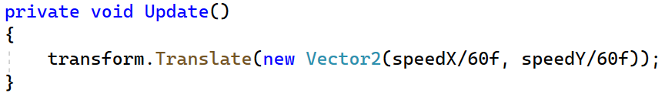
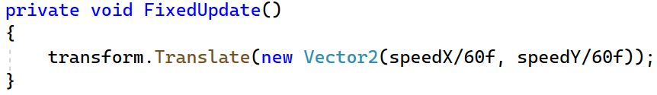
Frame rate?
Put the code in FixedUpdate, since we need to update the position at a fixed frame rate.
Why?
If not, the movement won’t look smooth.
Don’t hardcode!

Slide 9
Handling Collisions
boundary collision
X-axis aligned
Y-axis aligned

Slide 10
+
transform.position.x
transform.position
transform.position.y
+
If the ball y position is greater than the wall y position, a collision has occurred.
If the ball y position is less than the wall y position, a collision has occurred.

Slide 11
// handle the collision
If the y position of ball is greater than the y position of topWall
OR
If the y position of ball is less than the y position of bottomWall

Slide 12
// handle the collision
What do we do here?

Slide 13
When the top or bottom wall is hit, the ball’s speedY must be reversed.
speedY = -speedY
-speedY
speedX
speedY
speedY
-speedY
Remember, speedY is a variable, so its value can change(be +ve or –ve)

Slide 14
What about the left and right walls?
speedX = -speedX
In Pong, the ball won’t bounce off the left and right walls, but we’ll do that here just to keep it moving without the need to start a new game every time a paddle misses.
speedY is the same, but speedX is reversed.

Slide 15
More technically …
collision plane
collision plane
collision
- vel x
normal
vel y
Only the velcocity component along the collision normal is changed, i.e. horizontal for a vertical collision plane
vel y
collision
+ vel x
normal
The same is true for a horizontal collision plane, where the collision normal is parallel to the Y axis, and only the Y velocity changes
The change in velocity occurs along the collision normal, i.e. the force of the collision on the ball is along the collision normal only!
Let’s see how to implement this …

Slide 18
Problem?
Intersection!
+
+
+
height
+
Y position + radius
+
width
+
radius = height/2
+
w and h are the same for a circle
Y position - radius

Slide 19
Problem?
+
+
+
+
+
if ball position y + ball radius > topWall position y – topWall height/2
then a collision has occured
What about the other walls?

Slide 20
Initialise outside the function!
How to design this code better?
Previous
Improved
Notes:
Use functions to get the ballTop and ballBottom values – don’t have the same code in multiple places!?

Slide 21
Problem?
Handle any overlap before setting the new velocity
+
+
+
+
+
+
Let’s go through the actual code now!
xpos = leftWall.transform.position.x + wallOffsetX + radius
transform.position = new Vector3(xpos,
transform.position.y,
transform.position.z)

Slide 22
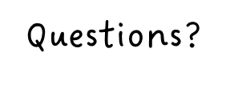

Slide 23
Now do Parts 1 and 2 of GMAPS_Collisions_Worksheet.docx

